Slide 1
Chapter 2 Vocabulary
Vocabulary Word | Definition from the Yellow book/Glossary on my wiki!
Nomad/nomadic | A person with no fixed residence who roams about; a wanderer.
Vegetation | Plants in a specific region or area
Agriculture/agricultural
Diffusion/cultural diffusion
Neolithic Era
Social hierarchy
Domestication/domesticated
Review word: geographic

Slide 2
Warm-up
In the cartoon below, create a comic strip that shows how the invention of a computer/ipad has changed peoples lives. Complete the dialogue from the year 1950 and from today-2014 to explain what life was like in both years with/without the computer.
Year: 1950
Year: 2013

Slide 6
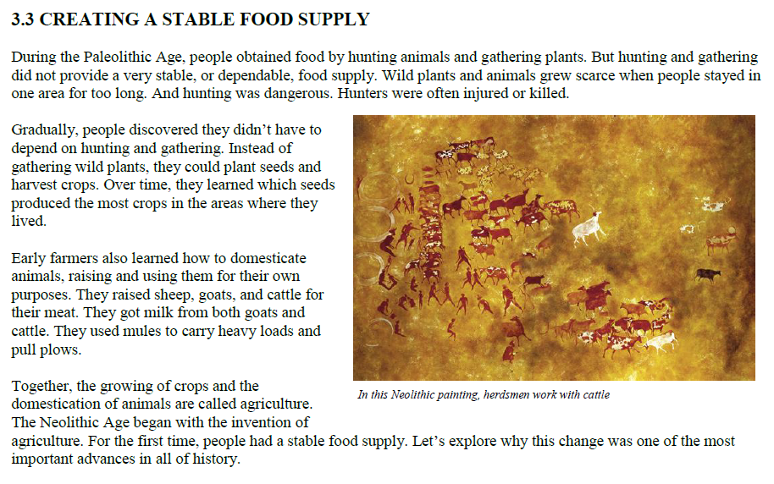

Slide 8
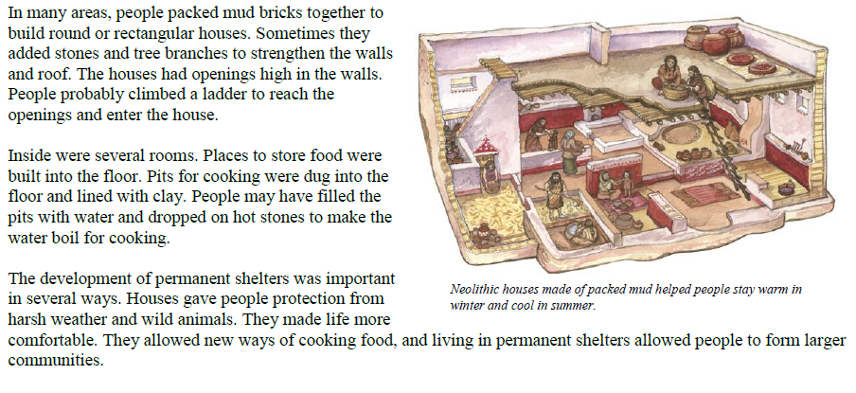

Slide 10
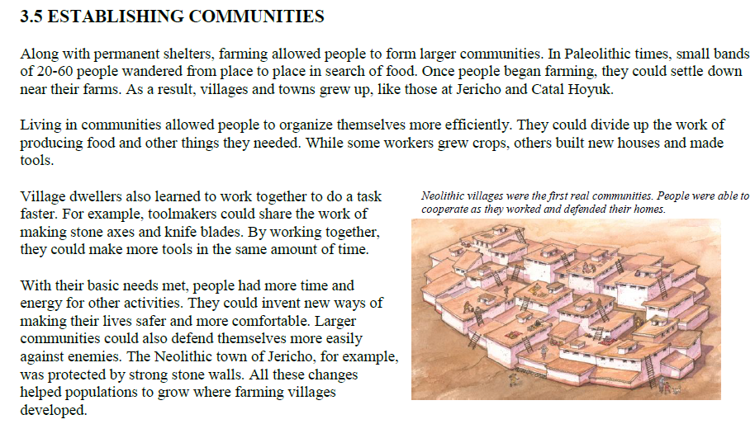

Slide 14
