Slide 1
Geography Vocabulary Copy words and definitions down into a chart on Page 6 of notebook. Then on page 7, illustrate 5 of the below words and label.
Word | Definition (from the book)
1. Map legend or key | gives symbols to represent places on a map
2. geography | the study of the earth and everything on it (people, places, environment)
3. Map scale | compares distance on a map to distance on Earth
4. Equator | an imaginary line that run around the center of Earth, halfway between the North and South Poles at 0 degrees latitude
5. Migrate | to move from one geographic region to another
6. Immigrant | a person who leaves one area to settle in another
7. Refugee | a person who flees a place to find safety
8. Compass rose | a directional arrow that shows cardinal and sometimes intermediate directions on a map
9. Cardinal directions | directions of north, south, east, and west
10. Political map | a map that shows human-made features and boundaries such as cities, highways, and countries

Slide 2
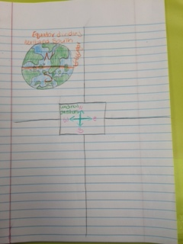
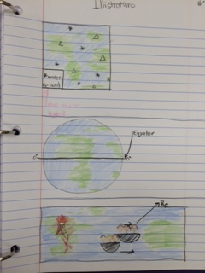
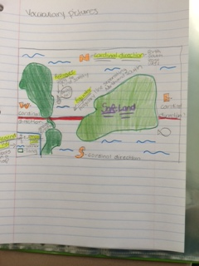
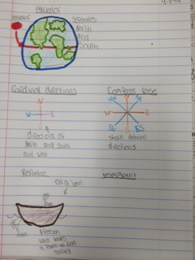
Vocab Drawing Example

